Slide 1
Dependability Analysis
Kristóf Marussy, István Majzik

Slide 2
Main topics of the course
Overview (1)
V&V techniques, Critical systems
Static techniques (2)
Verifying specifications
Verifying source code
Dynamic techniques: Testing (7)
Developer testing, Test design techniques
Testing process and levels, Test generation, Automation
System-level verification (3)
Verifying architecture, Dependability analysis
Runtime verification

Slide 3
Table of contents
1.
Attributes of dependability
Reliability, availability
Safety, integrity, maintainability
Combinatorial models for dependability analysis
Reliability block diagrams
Stochastic models for dependability analysis
Markov models (CTMC)
2.
3.

Slide 4
Learning outcomes
K2
Explain the attributes of dependability and the objectives of dependability analysis
Perform dependability analysis with reliability block diagrams
Perform dependability analysis of simple redundancy structures with Markov chains
Identify how reward analysis can be used for dependability analysis
K3
K3
K1

Slide 5
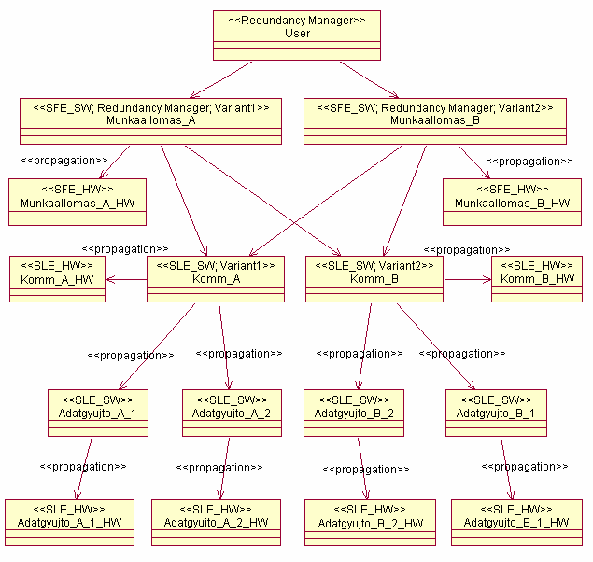
Attributes of dependability

Slide 6
Table of contents
Attributes of dependability
Combinatorial models
Stochastic models

Slide 7
Table of contents
Attributes of dependability
Combinatorial models
Stochastic models

Slide 8
Characterizing system services
Typical extra-functional characteristics
Reliability, availability, integrity, etc.
Characterize the faults occurring during the use of the services
Composite characteristic: Dependability
Role of dependability
Service Level Agreements (IT service providers)
Tolerable Hazard Rate (safety-critical systems)
Definition
Ability to provide service in which reliance can be justifiably placed
Reliance: the service satisfies the needs
Justifiably: based on analysis, evaluation, measurements

Slide 9
Characterizing system services
Typical extra-functional characteristics
Reliability, availability, integrity, etc.
Characterize the faults occurring during the use of the services
Composite characteristic: Dependability
Role of dependability
Service Level Agreements (IT service providers)
Tolerable Hazard Rate (safety-critical systems)
Definition
Ability to provide service in which reliance can be justifiably placed
Reliance: the service satisfies the needs
Justifiably: based on analysis, evaluation, measurements

Slide 10
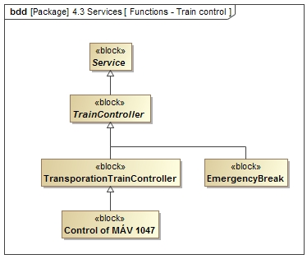
Generalization
Classification
Specification

Slide 11
Trapezoid
Use Drawing Tools → Format → Insert Shapes → Combine Shapes to Union or Intersect a triangle with a rectangle
Use the triangle from this slide to match the slope of the capital letter A

Slide 12
Creating exact outlines
Position two copies of the (trapezoid) shape on top of each other
The right angled side of the trapezoid should touch the slide edge
For a 2.5 pt outline, reduce the size of the shape by 5 pt
Make sure to keep the aspect ratio
Position the shape such that there is approximately 2.5 pt between the sloped sides of the trapezoids
Create a rectangle and Union it with the smaller trapezoid to let it touch the side of the slide again
Use Fragment to subtract the smaller shape from the outer one
A third copy of the (large) trapezoid is needed to add text inside
Remove its fill and outline, apply 0.3 in margin to clear the text of the angled side
Use outlines like this for mild emphasis, filled trapezoids for heavy emphasis

